Slide 1
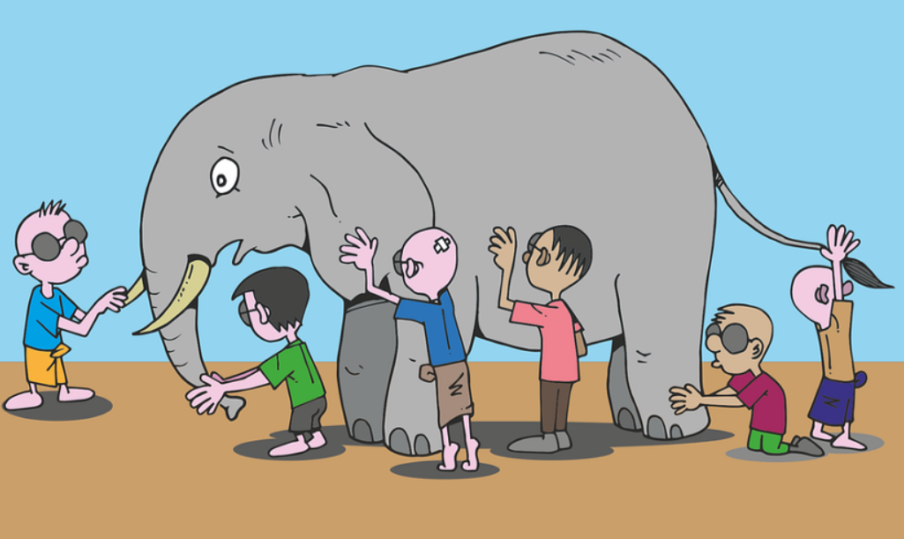
CSE 445: Machine Learning
Ensemble Learning
“The greatest intelligence would not be equal to a comprehension of the whole” – Mikhail Bakunin
Instructor: Syed Athar Bin Amir, North South University

Slide 2
What is Ensemble Learning
Scenario: you need to buy a smartphone. Do you…
walk into the nearest store and buy the first smartphone the salesperson shows you?
Extensively research the latest models, check reviews and specs online, consult friends and family, and THEN walk over to buy the phone?
If you do (b), you’re making decisions by an ensemble (i.e. “wisdom of the crowd”) – instead of a single factor (i.e. the salesperson)
Aggregating predictions of a group of predictors (ensemble) are better overall than the best individual predictor
Ensemble models in machine learning combine the decisions from multiple models to improve the overall performance.

Slide 3
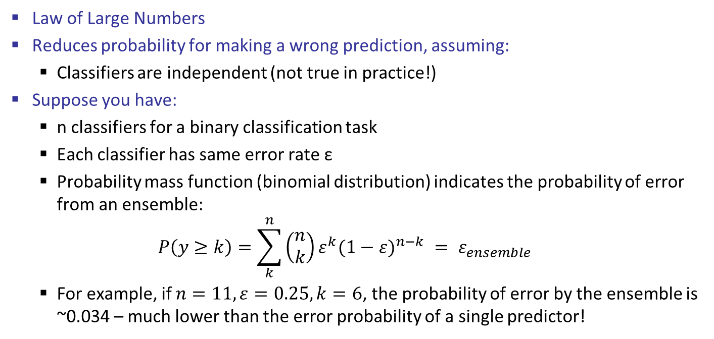
Why use Ensemble Learning?
Law of Large Numbers
Reduces probability for making a wrong prediction, assuming:
Classifiers are independent (not true in practice!)
Suppose you have:
n classifiers for a binary classification task
Each classifier has same error rate ε
Probability mass function (binomial distribution) indicates the probability of error from an ensemble:
$$P\left(y≥k\right)=\sum_{k}^{n}{\left(\begin{matrix}n \\ k\end{matrix}\right)ε^{k}{(1−ε)}^{n−k} }= ε_{ensemble}$$
For example, if $n=11, ε=0.25,k=6$, the probability of error by the ensemble is ~0.034 – much lower than the error probability of a single predictor!

Slide 4
Classifier Independence
Classifiers are not guaranteed to be independent of each other – i.e. errors may be correlated
However, we can:
Use different algorithms → every algorithm has its own strengths and weaknesses, having a variety will help achieve lower error rate
Use different features → different features capture different aspects of a particular class – using a variety helps!
Use different training data → subject different models to different subsets of training data to reduce variance error

Slide 5
Recall: Bias/Variance Trade-off
ML model’s generalization error comes from three sources:
Bias → generalization error due to wrong assumptions
e.g. assuming the data is linear when it’s actually quadratic
High bias will lead to underfitting
Variance → high sensitivity to small variations in training data
e.g. polynomial model with many degrees of freedom on quadratic data
High variance leads to overfitting
Irreducible error → due to inherent noise of the data itself
Make models more complex → higher variance, lower bias, overfitting
Make models less complex → lower variance, higher bias, underfitting
Need to strike a very delicate balance between the two

Slide 6
How to predict with an Ensemble?
Majority voting
Return the most popular prediction from multiple prediction algorithms
Bootstrap Aggregation – aka Bagging
Resample data to train algorithm on different random subsets
Boosting
Reweight data to train algorithm to specialize on “hard” examples – predecessor mistakes
Stacking
Train a model that learns how to aggregate classifiers’ predictions

Slide 7
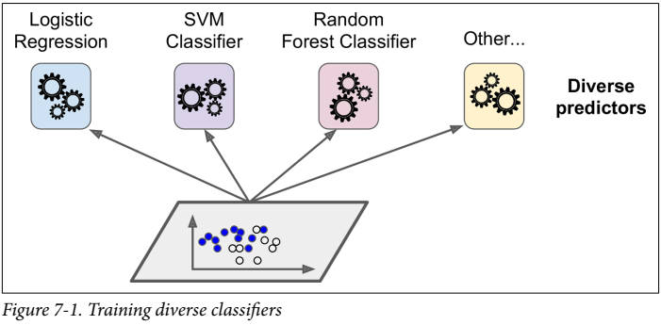
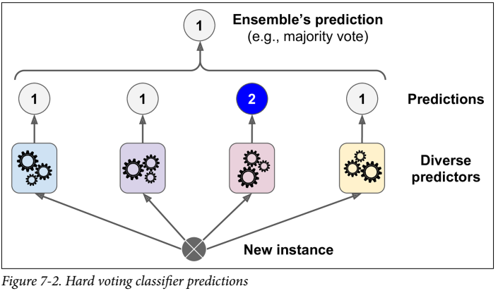
Majority Voting
Hard voting classifier: aggregate predictions of each classifier, and predict the class that gets the most votes
Often achieves higher accuracy than the best classifier in the ensemble
Even if each classifier is a weak learner, the ensember can be a strong learner
If trained on the same data, however, their errors are likely to be correlated!
Soft voting classifier: predict the class with the highest class probability, averaged over all individual classifiers
More weight to highly confident votes

Slide 8
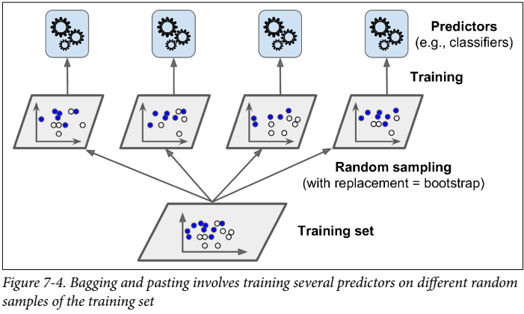
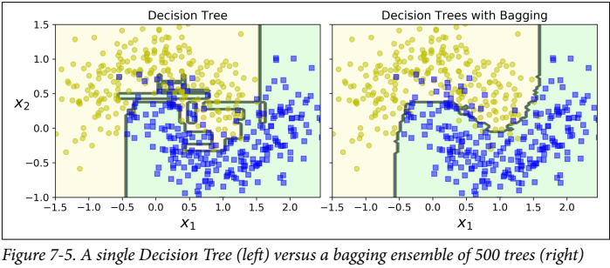
Bagging
Bagging
Short for Bootstrap AGGregatING
Use same algorithm on different random subsets of training set
When sampling is done with replacement, it’s bagging
When sampling is done without replacement, it’s pasting
Prediction made like majority voting

Slide 9
Bagging Example
Build ensemble from “bootstrap samples” drawn with replacement
Duplicate data can occur for training for bagging
No duplicate data in pasting
Some indices may be missing from training data
Each classifier is trained on a different subset of data
Sample indices | Bagging Round 1 | Bagging Round 2 | … | Bagging Round n
1 | 2 | 7 | … | 4
2 | 2 | 3 | … | 3
3 | 1 | 2 | … | 1
4 | 3 | 1 | … | 1
5 | 7 | 1 | … | 2
6 | 2 | 7 | … | 7
7 | 4 | 7 | … | 6

Slide 10
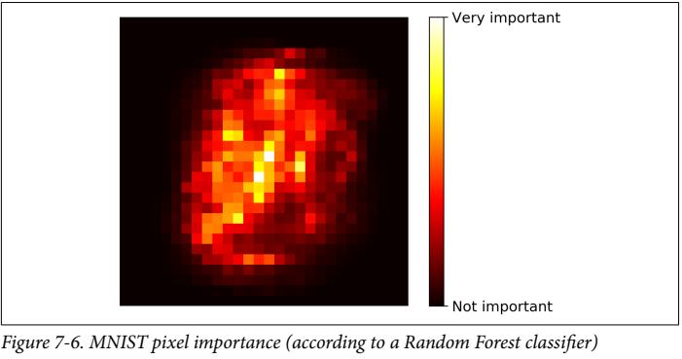
Random Forest
Random Patches → sampling both training instances as well as features
Random Forest → ensemble of Decision Trees, trained via bagging method
Instead of picking very best feature for node splitting, searches for best feature among a random subset of features
Higher bias for lower variance
Can find out which features are actually important for the model

Slide 11
Boosting – General idea
Boosting → sequentially train predictors that each try to predict examples that were hard for previous predictors
Original Algorithm:
Train classifier 1: use random subset of examples without replacement
Train classifier 2: use a second random subset of examples without replacement and add 50% of examples misclassified by classifier 1
Train classifier 3: use examples that classifiers 1 and 2 disagree on
Predict using majority vote from 3 classifiers
Most popular boosting methods are Adaboost (Adaptive Boosting) and Gradient Boosting

Slide 12
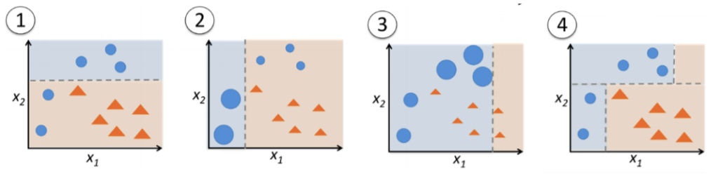
Adaboost
Assign equal weights to all examples
Assign larger weights to previous misclassifications, and smaller weights to previous correct classifications
Assign larger weights to training samples C1 and C2 disagree on, and smaller weights to previously correct classifications
Predict with weighted majority vote

Slide 13
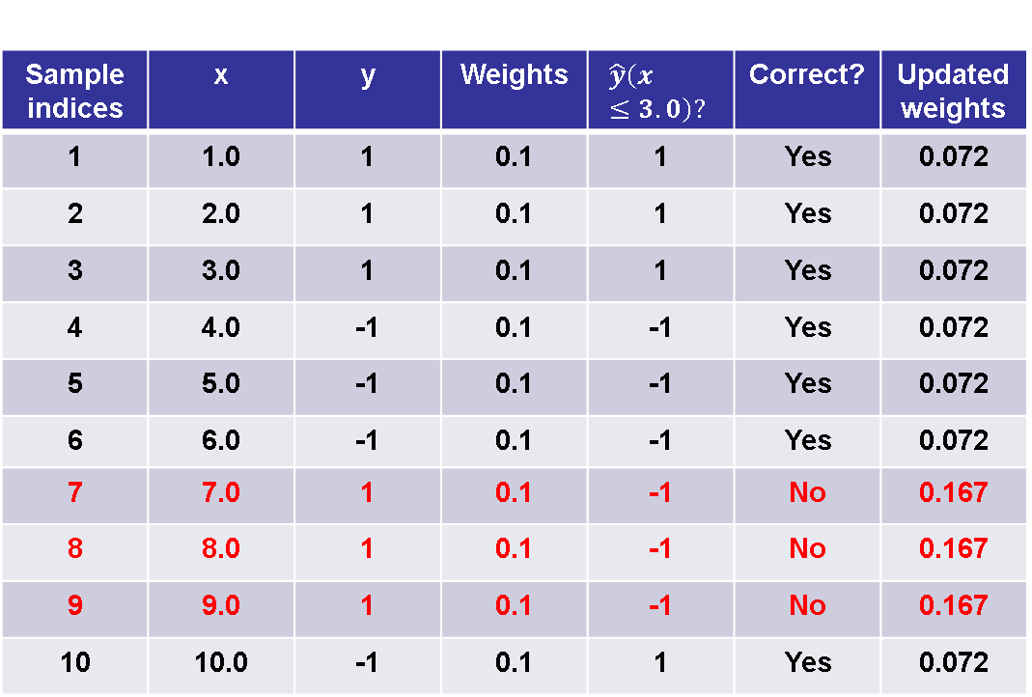
Adaboost Example – 1D dataset
Sample indices | x | y | Weights | $$\hat{y}\left(x≤3.0\right)?$$ | Correct? | Updated weights
1 | 1.0 | 1 | 0.1 | 1 | Yes | 0.072
2 | 2.0 | 1 | 0.1 | 1 | Yes | 0.072
3 | 3.0 | 1 | 0.1 | 1 | Yes | 0.072
4 | 4.0 | -1 | 0.1 | -1 | Yes | 0.072
5 | 5.0 | -1 | 0.1 | -1 | Yes | 0.072
6 | 6.0 | -1 | 0.1 | -1 | Yes | 0.072
7 | 7.0 | 1 | 0.1 | -1 | No | 0.167
8 | 8.0 | 1 | 0.1 | -1 | No | 0.167
9 | 9.0 | 1 | 0.1 | -1 | No | 0.167
10 | 10.0 | -1 | 0.1 | 1 | Yes | 0.072

Slide 14
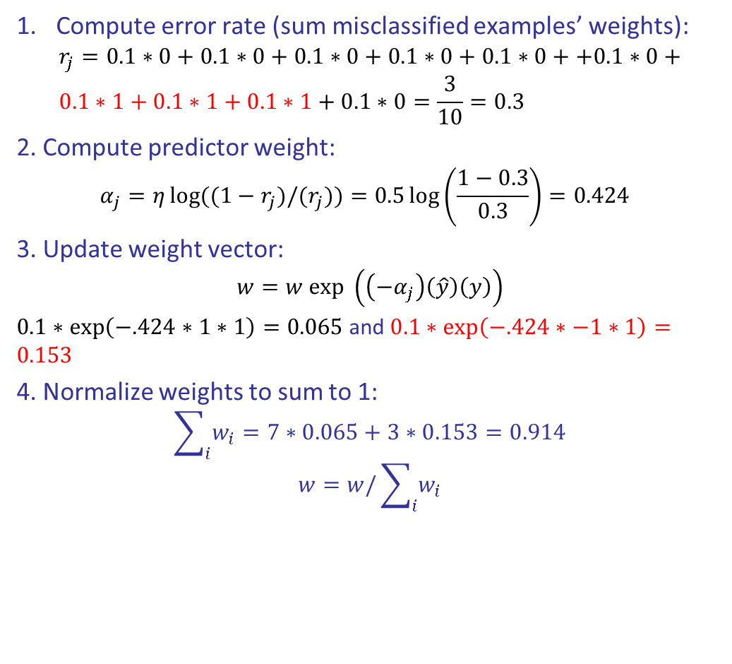
Adaboost Example
Compute error rate (sum misclassified examples’ weights):
$$r_{j}=0.1∗0+0.1∗0+0.1∗0+0.1∗0+0.1∗0++0.1∗0+ \\ 0.1∗1+0.1∗1+0.1∗1+0.1∗0=\frac{3}{10}=0.3$$
2. Compute predictor weight:
$$α_{j}=η\log{((1−r_{j})/(r_{j}))}=0.5\log\left(\frac{1−0.3}{0.3}\right)=0.424$$
3. Update weight vector:
$$w=w exp \left(\left(−α_{j}\right)\left(\hat{y}\right)\left(y\right)\right)$$
$0.1∗\exp\left(−.424∗1∗1\right)=0.065$and $0.1∗\exp\left(−.424∗−1∗1\right)=0.153$
4. Normalize weights to sum to 1:
$$\sum_{i}{w_{i}}=7∗0.065+3∗0.153=0.914$$
$$w=w/\sum_{i}{w_{i}}$$
Sample indices | Correct? | Updated weights
1 | Yes | 0.072
2 | Yes | 0.072
3 | Yes | 0.072
4 | Yes | 0.072
5 | Yes | 0.072
6 | Yes | 0.072
7 | No | 0.167
8 | No | 0.167
9 | No | 0.167
10 | Yes | 0.072

Slide 15
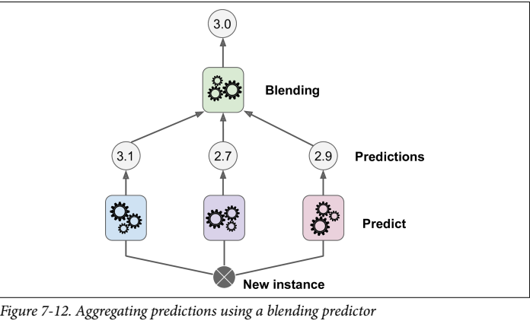
Stacking
Stacked Generalization
Instead of using hard voting to aggregate the predictions of all predictors, why not train a model to perform the aggregation itself?
Final predictor (called blender, or meta learner) takes predictions made by each of the ensemble predictors and makes a final prediction

Slide 16
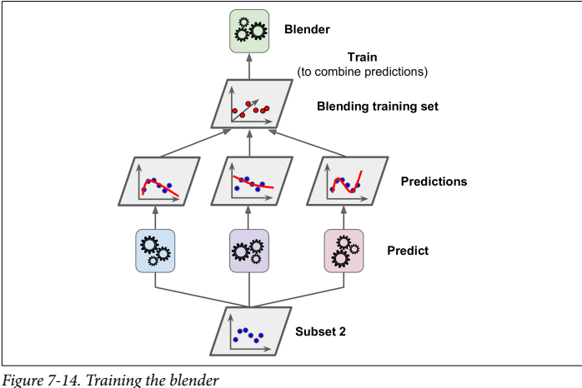
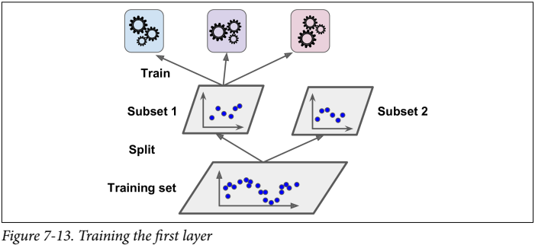
Stacking Algorithm
Split dataset into 3 disjoint sets (training, hold-out, test)
Train base learners on the first partition
Test the base learners on the second partition and third partition
Train meta learner on second partition using base learners’ predictions as features
Evaluate meta learner on third partition using base learners’ predictions as features

Slide 17
Ensemble Learning – Pros and Cons
Pros:
Higher accuracy- often the winners of Machine Learning challenges
With Bagging, you can limit error from variance
With Boosting, you can limit error from bias
With Stacking, you can limit variance and bias error while improving accuracy
Cons:
Can be harder to interpret
More difficult to create and train
More difficult to DEPLOY in production (key reason why it’s not widespread in industry)

